Slide 1
Digital Media Technology Week 3: Introduction to TEI

Slide 2
Recapitulation
XML is a metalanguage
It prescribes general rules for the well-formedness of encoded documents
Schemas/DTDs list the elements that can be used in an encoded document, and defined the hierarchical relations between these elements

Slide 3
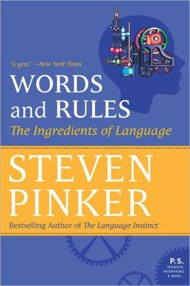
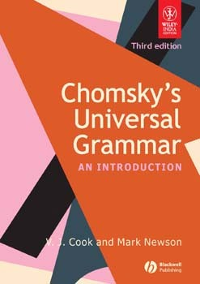

Slide 4
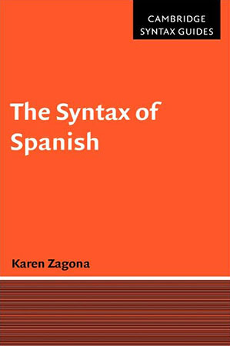


Slide 5
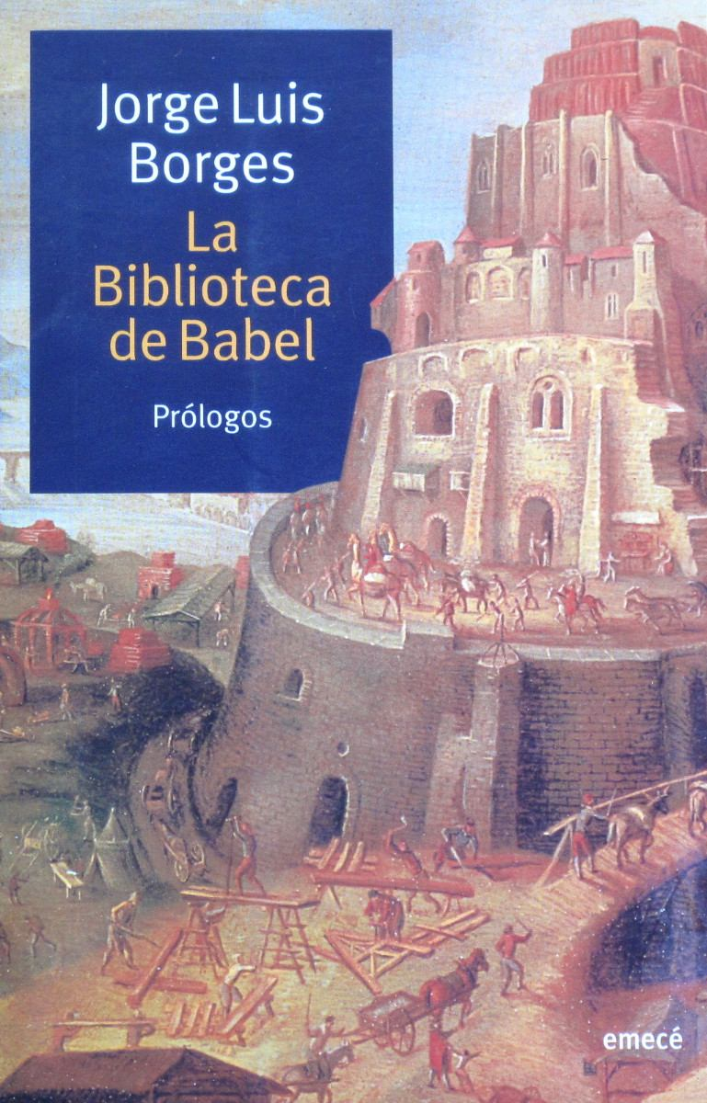


Slide 6
XML
HTML
TEI
SVG
EAD
EPUB

Slide 7
Entities
XML makes use of reserved characters, such as ‘<’, ‘>’ and ‘&’
When these characters are part of the text to be encoded, they must be represented as entities, which function as placeholders
The specifications define the following character entities:
Ampersand: &amp;
Greater than: &gt;
Less than: &lt;
Single quote: &apos;
Double quote: &quot;

Slide 8
<p>This sentence is in the &lt;p&gt; element.</p>
<p>Taylor &amp; Francis </p>

Slide 9
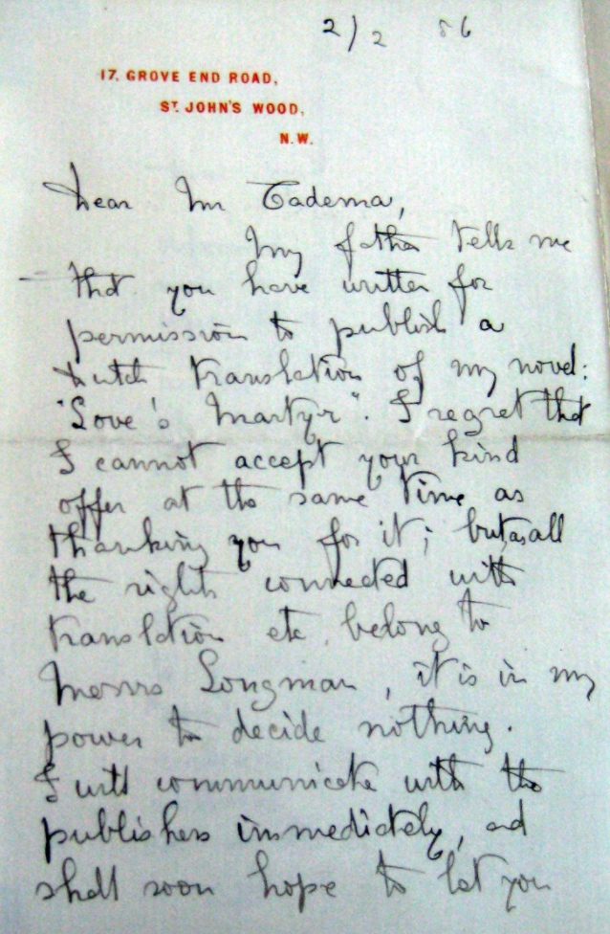

Slide 10
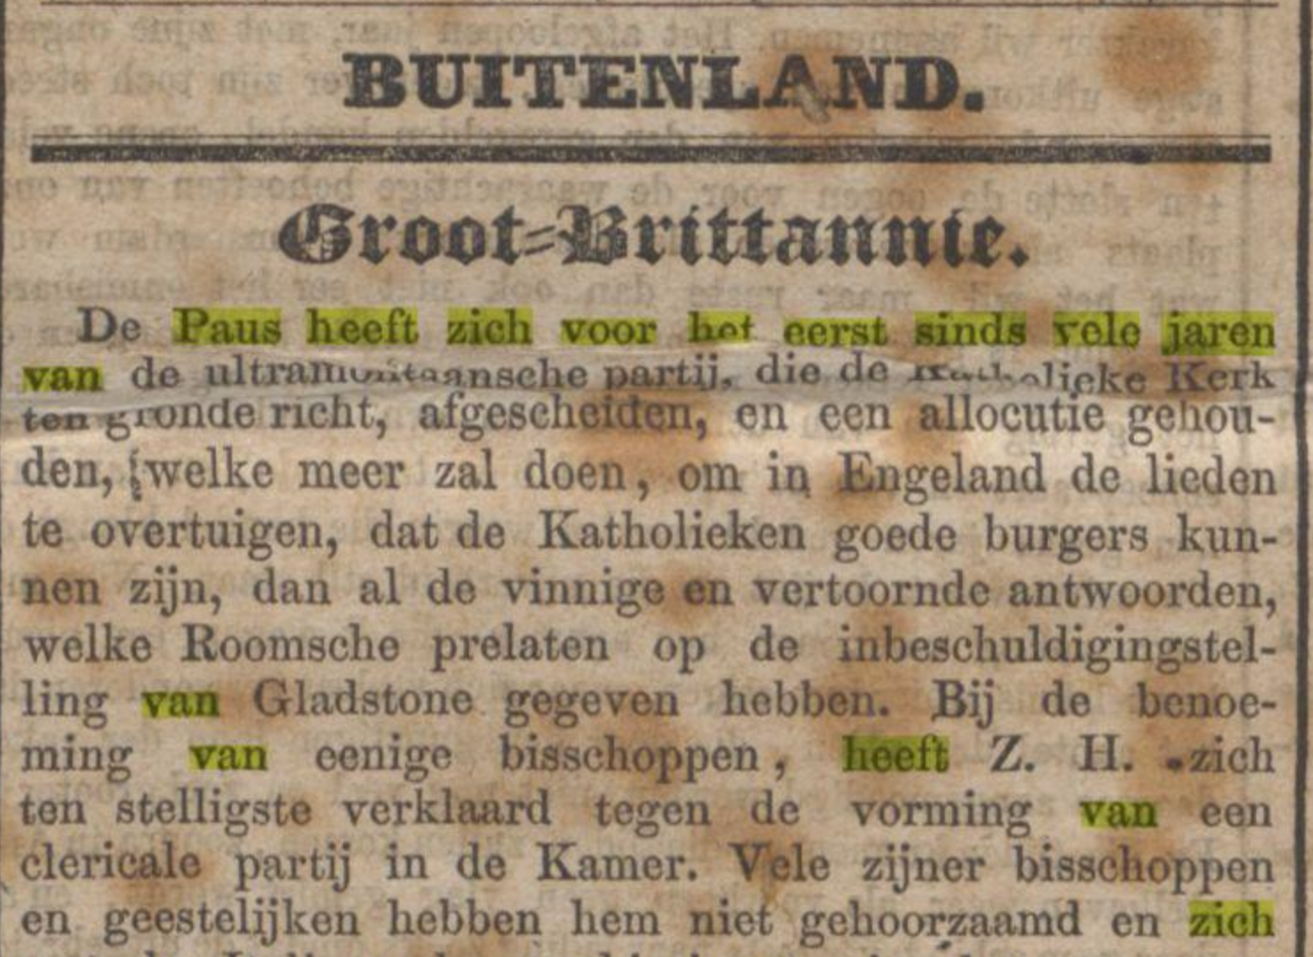
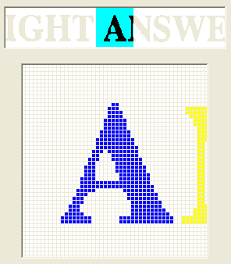
Optical Character Recognition
BUITENLAND. Groot=Brittannie.
Dc Paus heeft zich voor Kot eerst sinds vele jaren van dc ultnuumitaansche aatti-i» die da __r_.ti. „i ipkjgfËMfrk urn gronde richt, afgesehflJßßÏf,

Slide 11
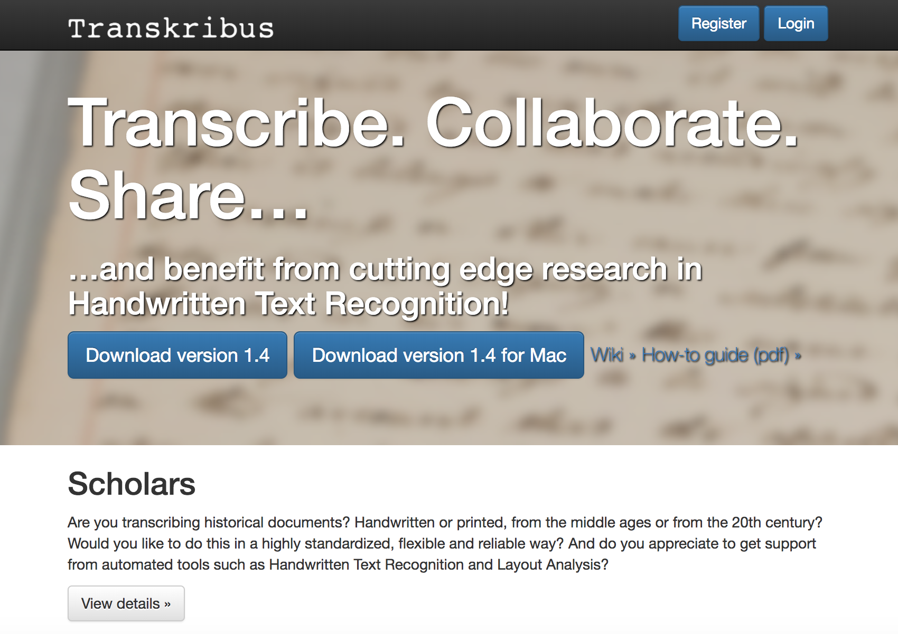

Slide 12

Digital information is numerical information; information represented as combinations of 1s and 0s
Eight bits form a byte (‘by eight’)
“Digital” derived from the Latin word ‘digitus’
0s and 1s can be used to represent binary numbers

Slide 13
Positional numerical systems are defined by the number of symbols they use. The position determines the order of magnitude
1575
5 * 10⁰
7 * 10¹
5 * 10²
1 * 10³
11001
1 * 2⁰
1 * 2³
1 * 2⁴
Binary
Decimal

Slide 14
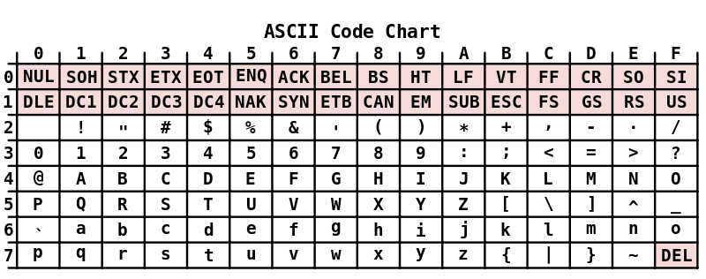
ASCII
Character encoding scheme
American Standard Code for Information Interchange
e.g.: A = 01100001
Uses 7 bits (128 characters)

Slide 15
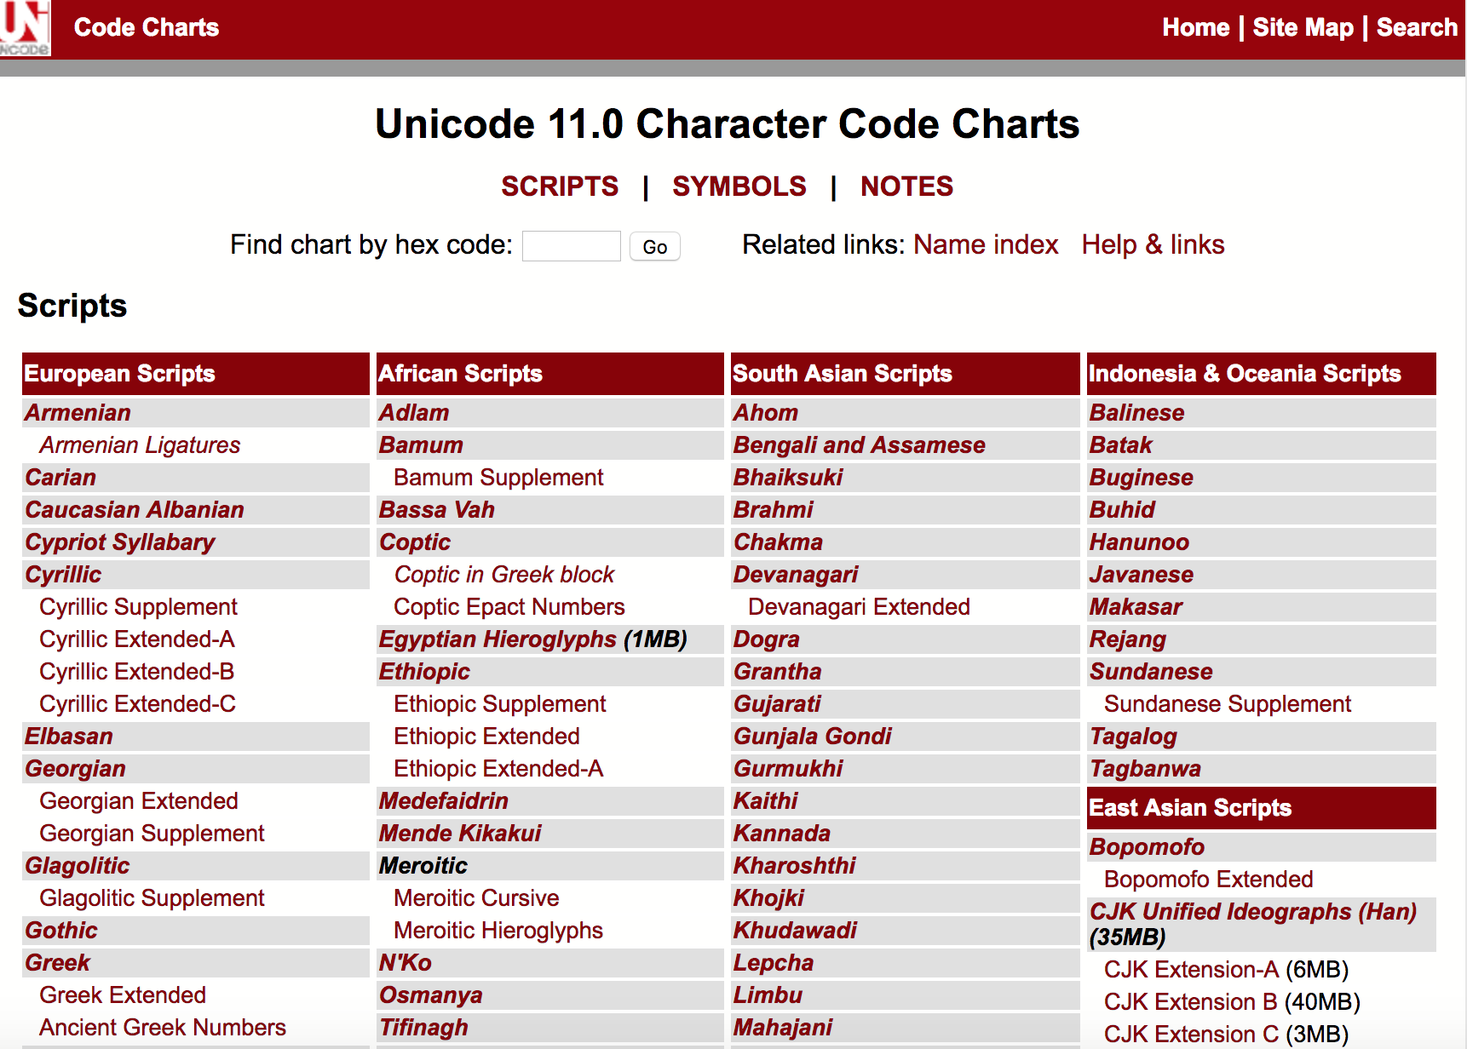
Unicode
16 bits
UTF-8
1,112,064 characters

Slide 16
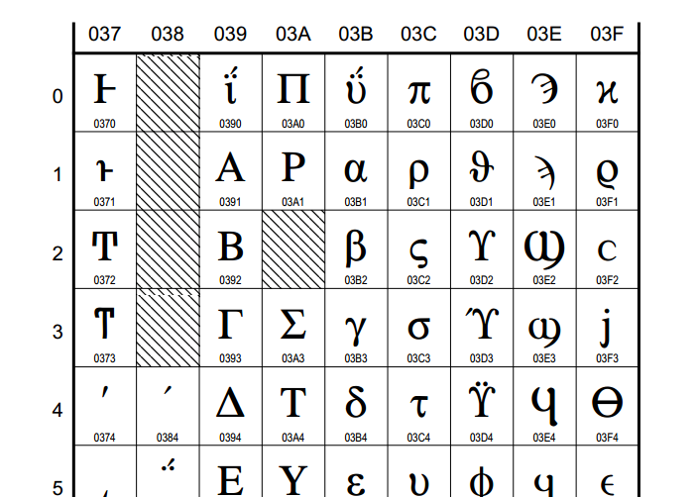
Character code charts at Unicode.org mentions codes in hexadecimal notation
In XML, codes must be preceded by ‘&#x’ and followed by ‘;’
Δ: &#x394;

Slide 17
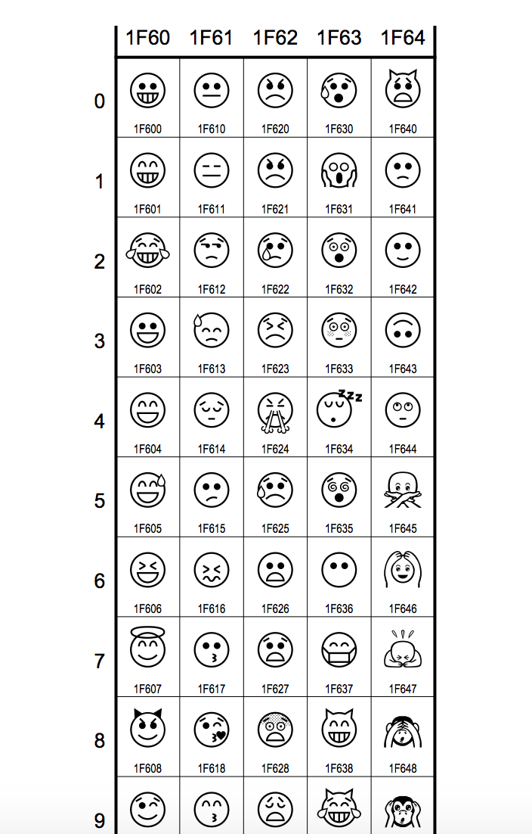

Slide 18
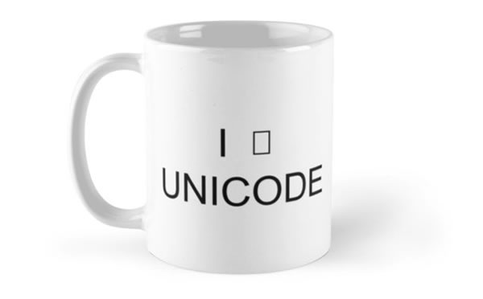
<p>En r&#xE9;ponse &#xE0; votre lettre du 30 Janvier nous avons <lb/> l'honneur de vous informer que nous avons pay&#xE9; Mon-<lb/> sieur Midderigh d&#xE9;j&#xE0; depuis longtemps et presque toujours <lb/> d'avance.</p>

Slide 19
Lexical codes
Dear Mr. Tadema,
My father tells me that you have written for permission to publish a Dutch translation of my novel “Love‘s Martyr”. I regret that I cannot accept your kind offer at the same time as thanking you for it; but as all the rights connected with translation etc. belong to Messrs Longman, it is in my power to decide nothing. I will communicate with the publishers immediately, and shall soon hope to let you have a favourable answer.
Believe me,
Faithfully yours,
Laurence Alma Tadema

Slide 20
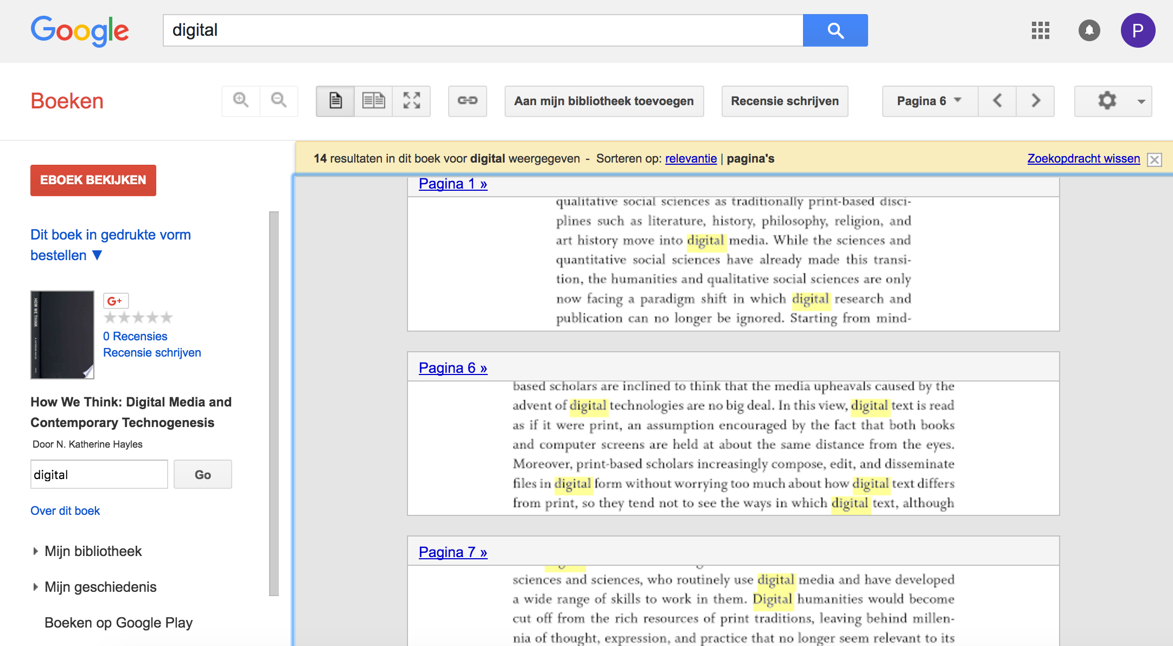

Slide 21
Gentlemen,
I reply to your letter of the 29th Ulto, offering 30 £ for an early copy of my late father's forthcoming novel Kenelm Chellengly. I beg to inform you that I have simultaneously received from another Dutch Firm, precisely the same offer, viz. 30 £ for an early copy of that work, with a view to a Dutch translation of it (…). Your obedt. Servt,
Lytton Knebworth Park Stevenage Herts

Slide 22
<?xml version="1.0" encoding="UTF-8"?>
<!DOCTYPE TEI SYSTEM "tei.dtd " >
<tei>
<text>
<salute>
Gentlemen, </salute>
<body>
I reply to your letter of the <date value=“1873-10-29”>29th Ulto</date>, offering 30 £ for an early copy of the novel (…)
</body>
</text>
</tei>
Validation rules
DTD or XML Schema
Document Instance

Slide 23
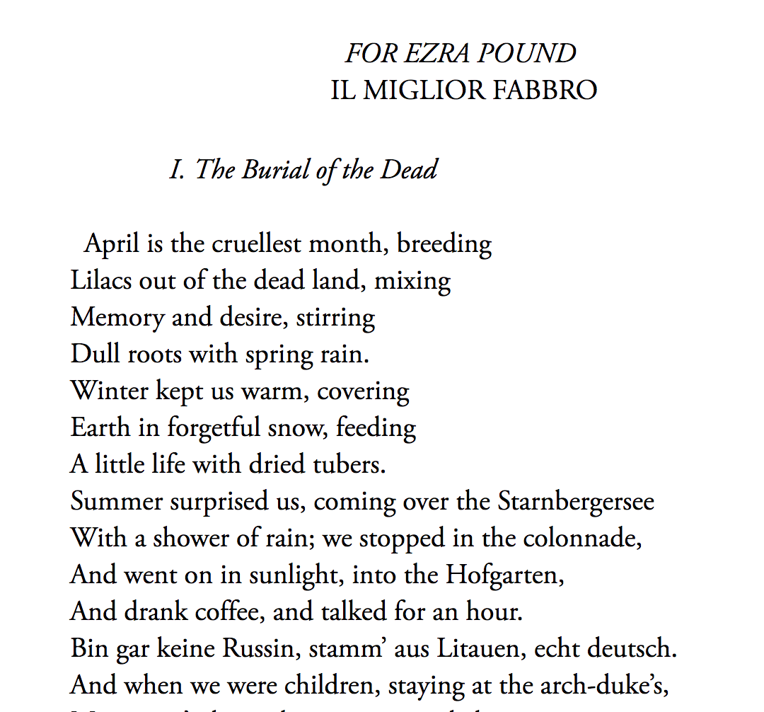
Deconstruction
Logical structure: division into chapters, sections paragraphs
Physical structure: division ibto quires, pages
Typography: font type, font family, indentation
Literary devices

Slide 24
Ontologies
Models are based on an ontology
Ontologies describe the properties of the original which are represented in the model
A DTD can be viewed as an ontology

Slide 25

More than 500 elements
Developed by consortium of scholars
First established in 1987
Text in general: “texts in any natural language, of any date, in any literary genre”

Slide 26
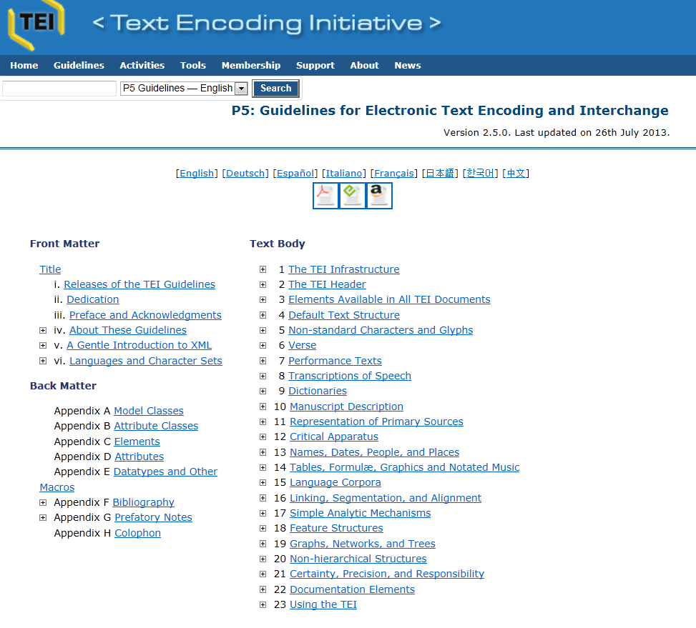

Slide 27
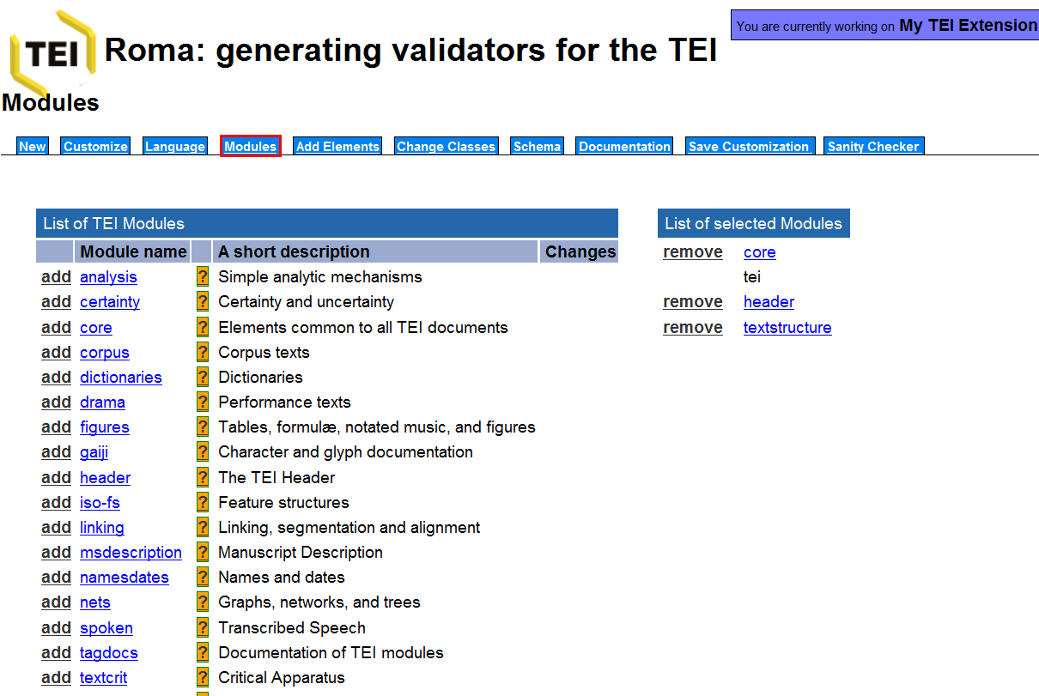

Slide 28
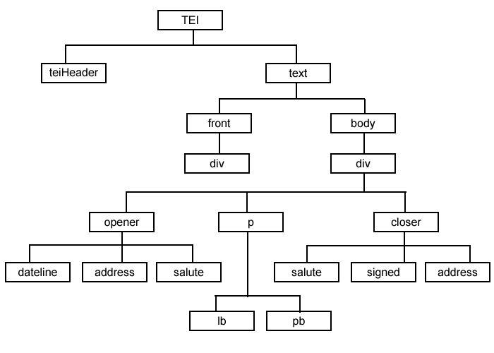

Slide 29
Ontology
XML-based encoding systems are based on models of “document types”
These can be referred to as ontologies: a series of statements about the aspects that need to be modelled
Ontologies are initially descriptive, but they become normative or prescriptive once they are fixed

